Slide 1



PROJECT – || Number Maze
CME1252 Project Based Learning - ||
By
2019510040 Rana Gül
2018510122 Tutku Ekin Bayrı
2019510128 Deniz Küçükkara
IZMIR

Slide 2
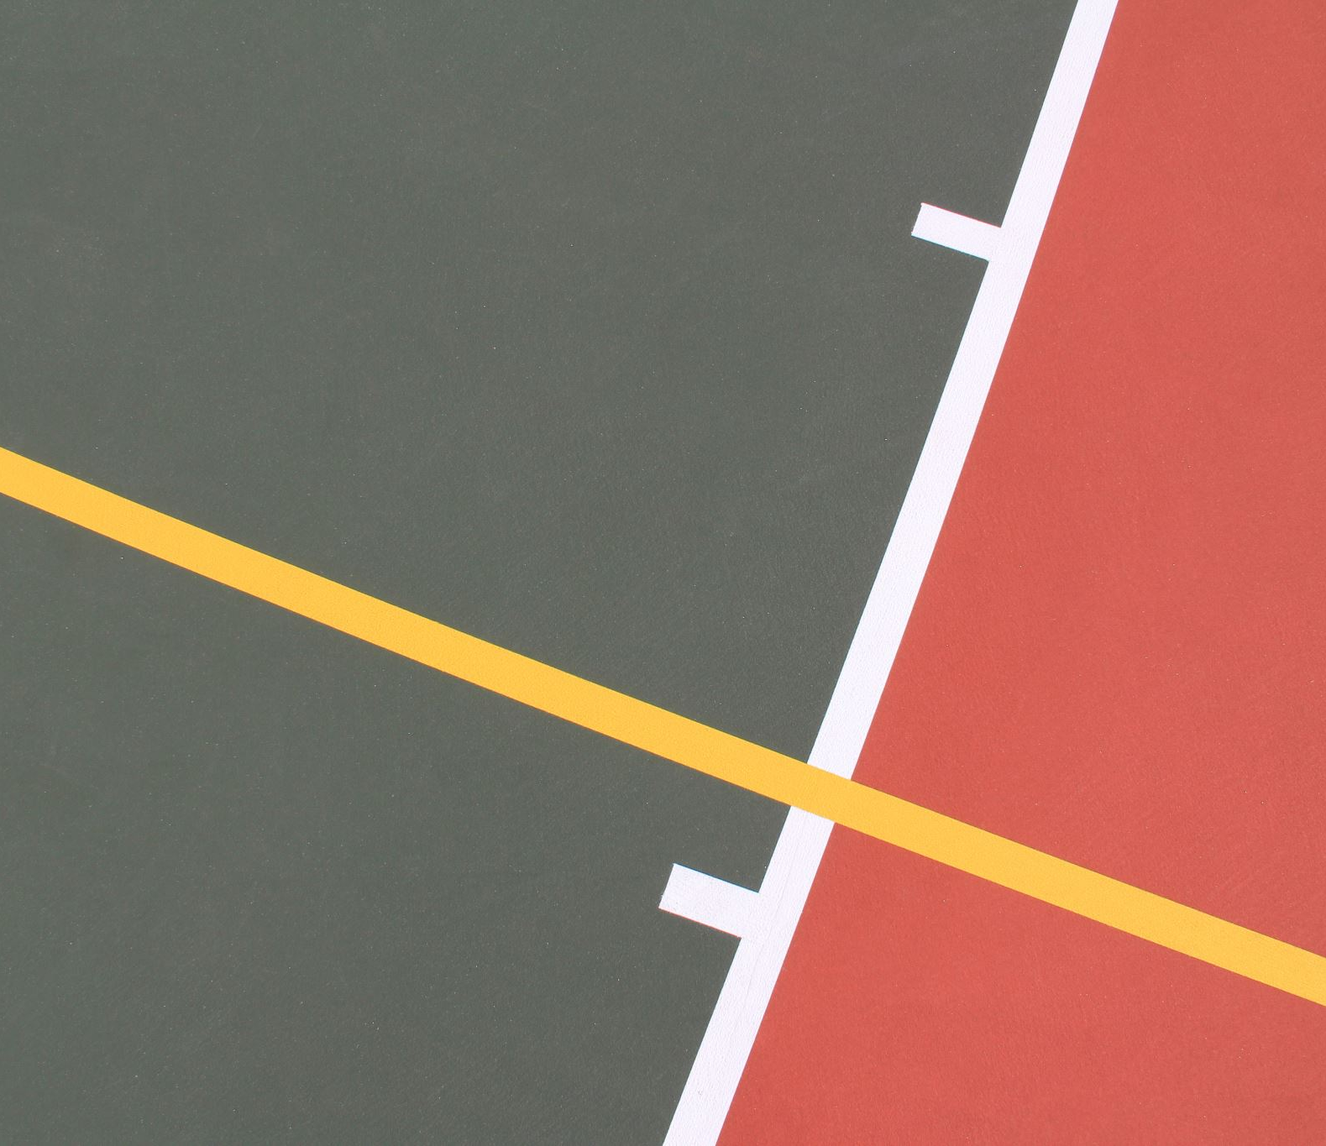
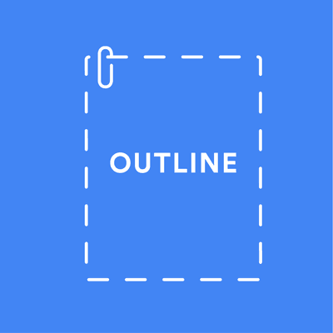
Outline
INTRODUCTION
PROGRESS SUMMARY
Requirements
Task Sharing
Scheduling
Completed Tasks
Incomplete Tasks: Reasons, Explanations
Additional Improvements
SCREENSHOTS
PROBLEMS ENCOUNTERED
ALGORITHMS AND SOLUTION STRATEGIES
conclusıon
REFERENCES

Slide 3

Introduction
The aim of our project is to create a game based on eating the numbers in the maze.
The aim of the game is reaching the highest score by collecting and matching the computer numbers.

Slide 4




Requirements
Eclipse to use java
Discord to communicate
Canva for poster

Slide 5

Task Sharing
Deniz
Movements of all of the numbers
Capturing of numbers
Writer function for screen
Calculate high scores, print on the screen
Preparing the report and presentation
Rana
Creating the Number class
Create an input queue and send to maze
Creating a menu and a login screen
Creating normal and hard mode
Adding background music to the game
Writing a path finding algorithm
Creating the Coordinate class
Making a poster, preparing a report, organizing the presentation.
Tutku
Creating Backpack class and writing its operations, functions
Creating Time class and writing its operations, functions
Creating a path finding algorithm
Creating the Coordinate class
Control of the numbers that move twice
Preparing the report

Slide 6

Scheduling
First Week: Meeting, talking about how to do things, preparing an algorithm, and planning.
Second Week: Printing maze txt file, inserting static numbers, movement of random numbers and user's movements, condition checks.
Third Week: Eating status control, creating backpack, creating input with circular queue, calculating points when eating ,and time control.
Fourth Week: The movement of red numbers (7,8,9), the algorithm to find the right way to the user. Editing and shortening the code.
Fifth Week: Poster and presentation preparation, final checks and debug.

Slide 7
Completed Tasks
Maze is created
Time is setted
All statuses between numbers are checked.
Movements have been adjusted for all numbers and for the user
Bags are created

Slide 8

Incompleted Tasks
All assigned tasks have been completed

Slide 9

Additional Improvements
A menu has been added to provide the user with normal and hard mode options.
Background music has been added for a better gaming experience.
Continuity was provided in the game and high score table was added.

Slide 10
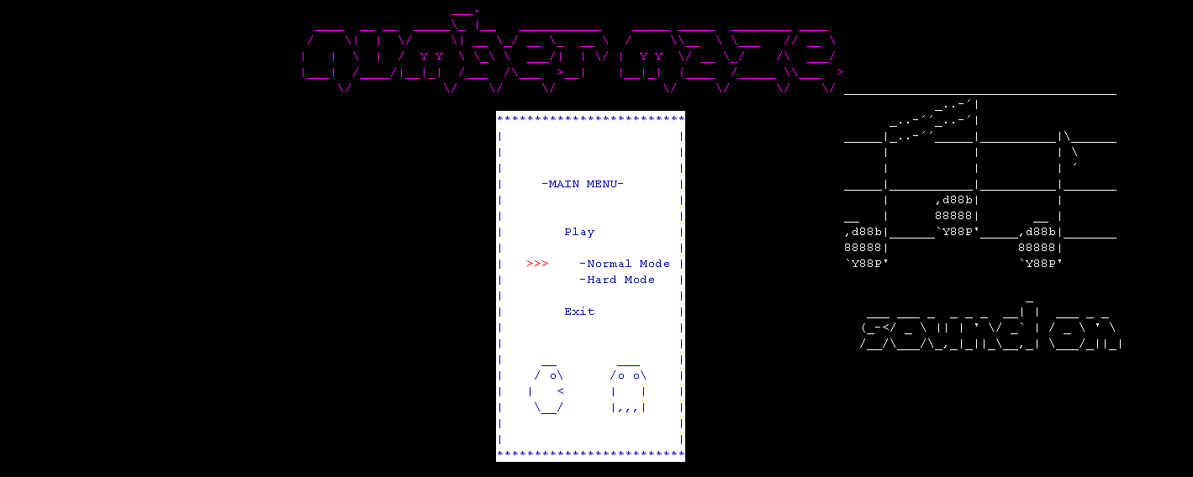
Screenshots

Slide 11
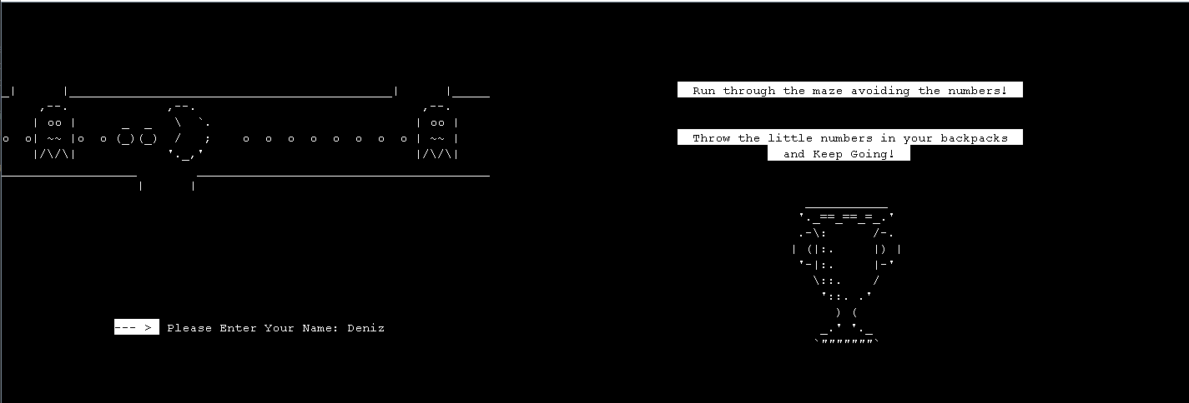
Screenshots

Slide 12
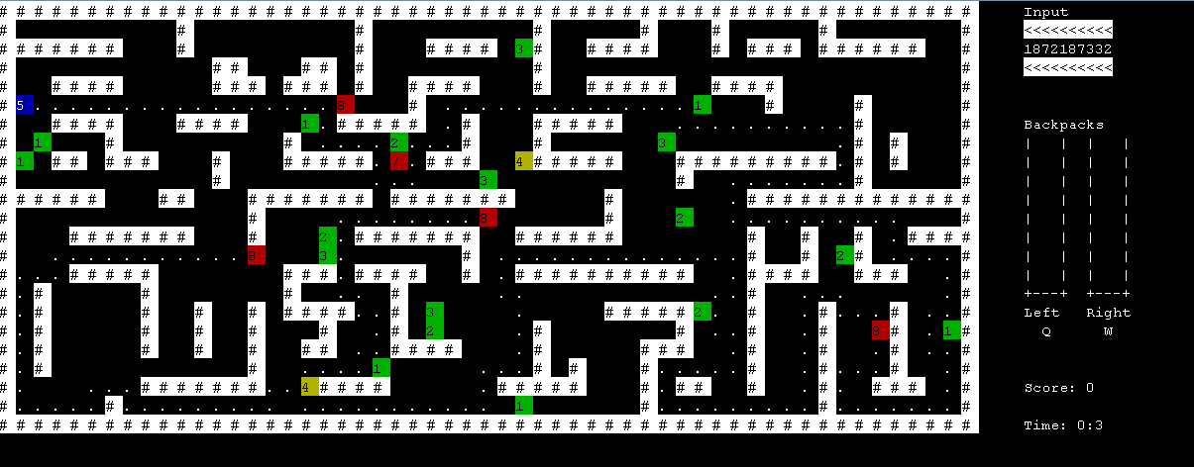
Screenshots

Slide 13
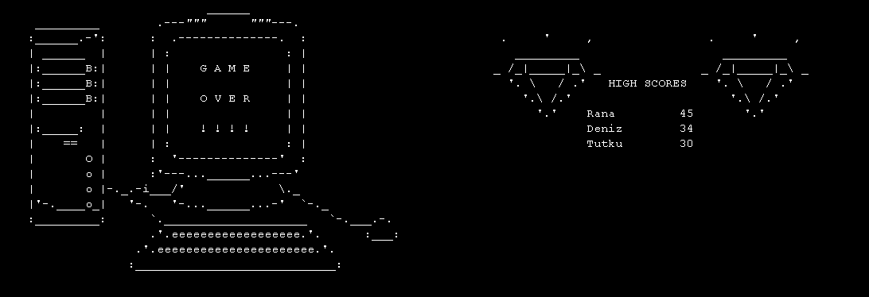
Screenshots

Slide 14
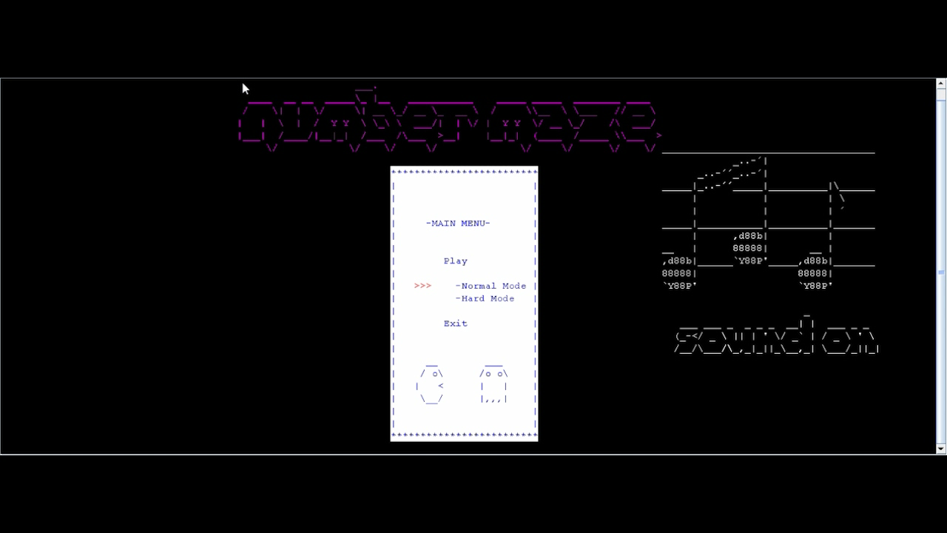
Screen Record

Slide 15
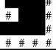

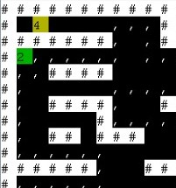
Problems Encountered
While writing the input part, we encountered the "queue empty" error because we haven't learned the "circular queue" yet.
While writing the pathfinding function of red numbers, we constantly encountered stack is empty and stack overflow errors.
Setting the background color to white

Slide 16
Algorithms & Solutions Strategies
First of all, we did the necessary research and drew a path for ourselves.
After that, we started to form the program gradually, even if we encountered problems that we could not foresee, we tried to solve them.
We found solutions by helping each other and researching together in places where we usually hang out.

Slide 17
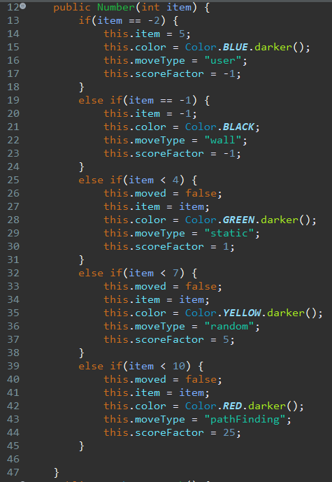

Slide 18
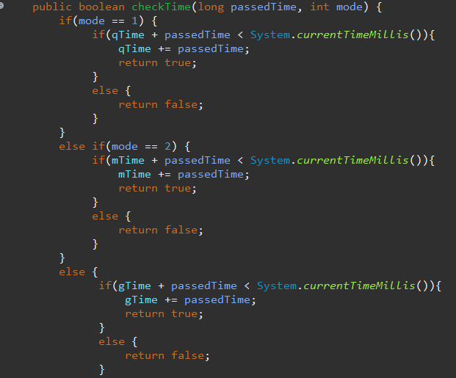

Slide 19
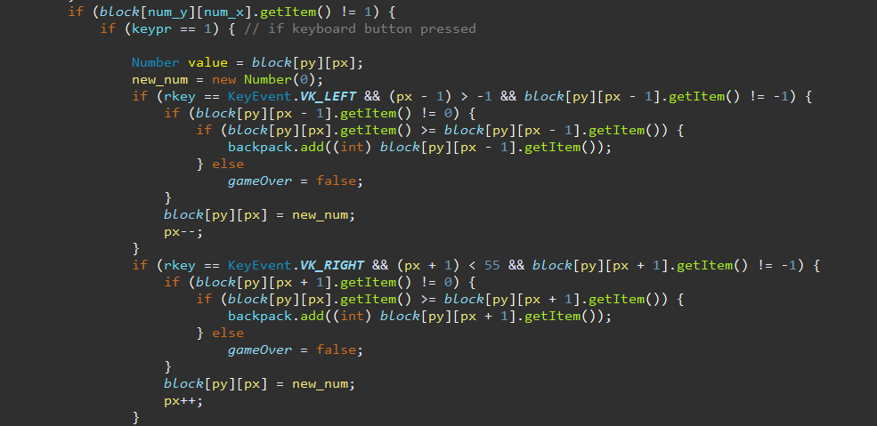

Slide 20
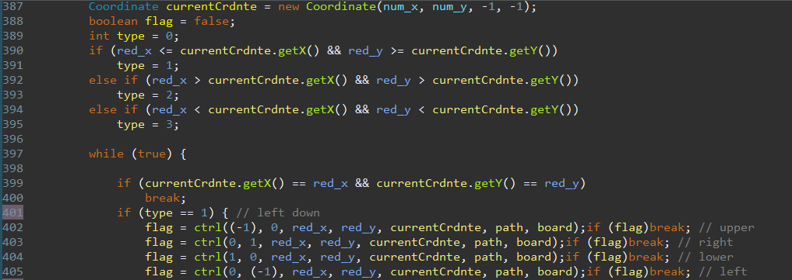

Slide 21


In this project, we learned
The use of enigma
Use of class structures.
Use of stacks and queues
How to act as a team.
How to manage time.

Slide 22
References
https://www.java.com/
https://www.stackoverflow.com/
https://www.tutorialspoint.com/java/java_files_io.htm
https://github.com/mikepound/enigma

